Slide 1
Lesson 9
Visualization 2
Kush Kulshrestha

Slide 2
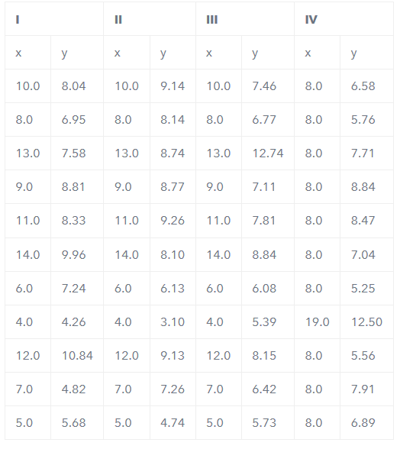
Why do we even need Viz?
There could be datasets that appear to be similar when using typical summary statistics, yet tell different stories when graphed.
Example, each dataset consists of eleven (x,y) pairs as follows:

Slide 3
Why do we even need Viz?
Observations:
The average x value is 9 for each dataset.
The average y value is 7.50 for each dataset
The variance for x is 11 and the variance for y is 4.12
The correlation between x and y is 0.816 for each dataset
So far these four datasets appear to be pretty similar. But when we plot these four data sets on an x/y coordinate plane, we get the following results:

Slide 4
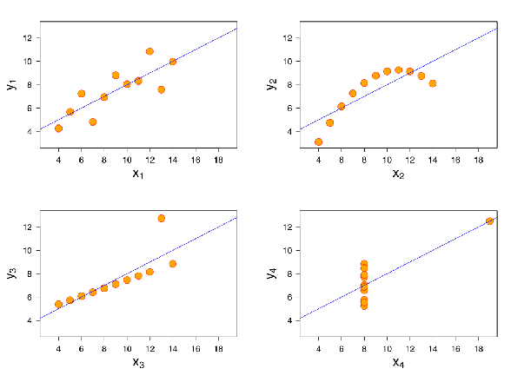
Why do we even need Viz?
Now we see the real relationships in the datasets start to emerge

Slide 5
Why do we even need Viz?
Dataset I consists of a set of points that appear to follow a rough linear relationship with some variance.
Dataset II fits a neat curve but doesn’t follow a linear relationship (maybe it’s quadratic?).
Dataset III looks like a tight linear relationship between x and y, except for one large outlier.
Dataset IV looks like x remains constant, except for one outlier as well.
Computing summary statistics or staring at the data wouldn’t have told us any of these stories. Instead, it’s important to visualize the data to get a clear picture of what’s going on.

Slide 6
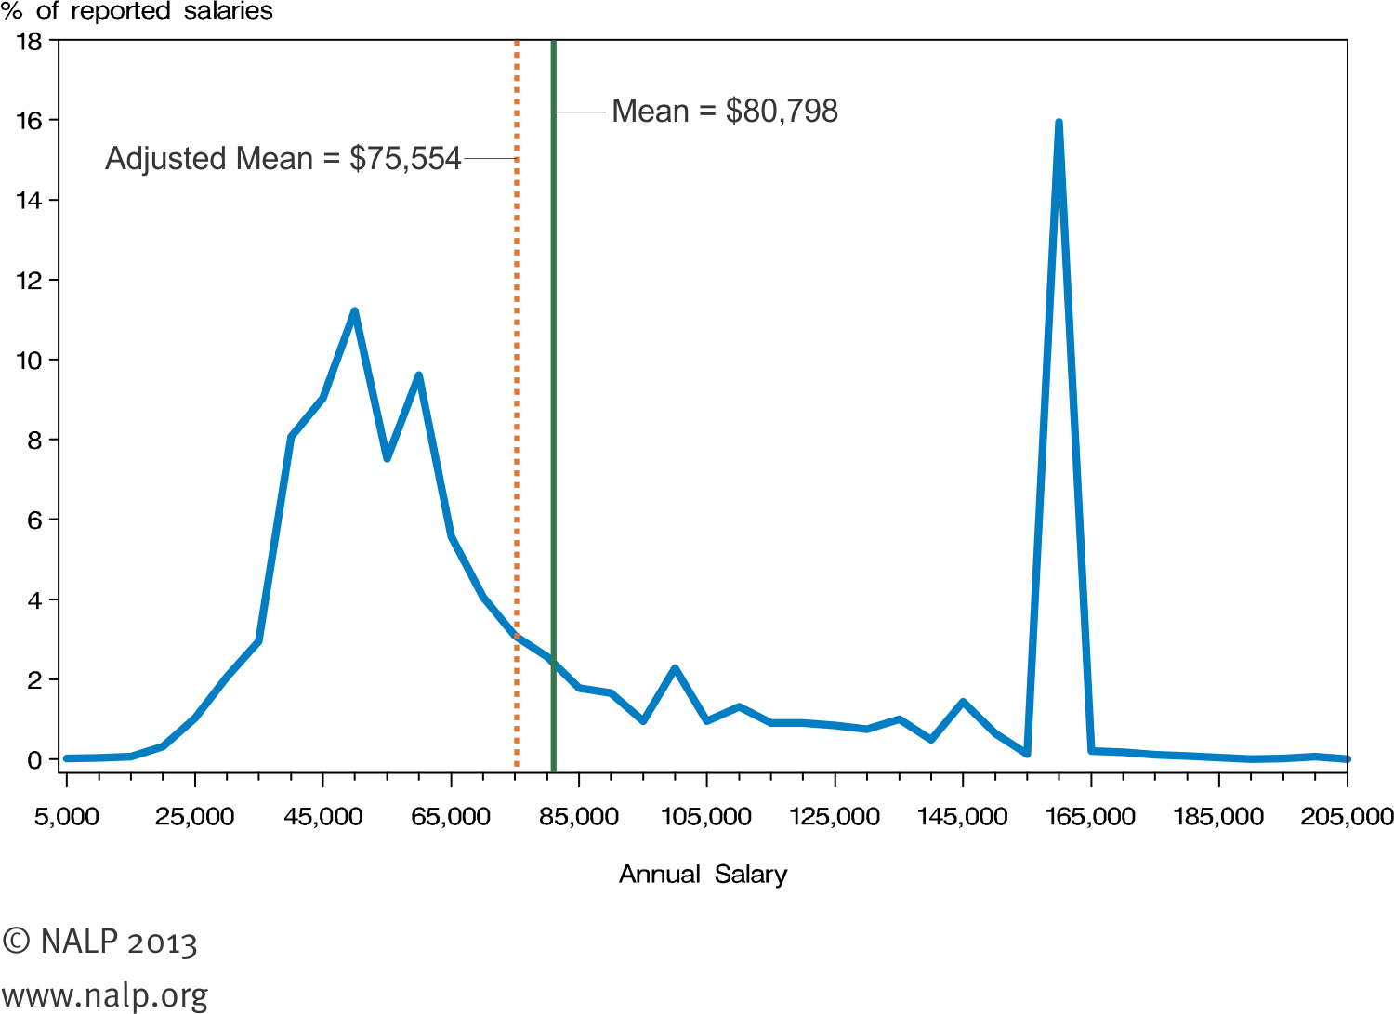
Why do we even need Viz? One more Example

Slide 7
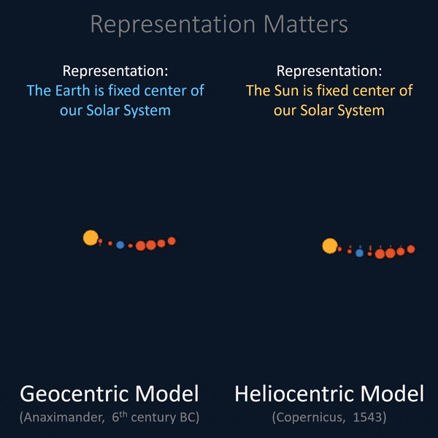
Representation Matters

Slide 8
Cognitive Load and Clutter
Cognitive Load is the amount of mental effort required to interpret information.
Cognitive Load
Intrinsic
Extraneous
Germane

Slide 9
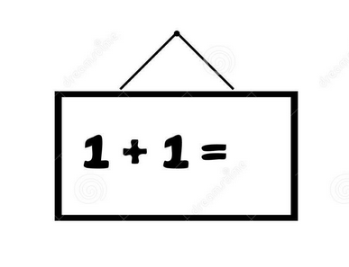
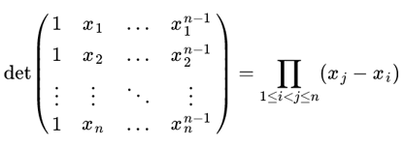
Cognitive Load and Clutter
Intrinsic Cognitive Load
Amount of memory we need to understand an idea.
Adding 2+2 is easier, doing difficult math division is difficult. If we don’t concentrate in the latter, we end up spending more time.

Slide 10
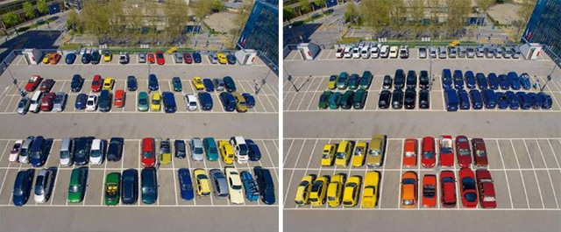
Cognitive Load and Clutter
Extraneous Cognitive Load
It relates to how information is presented.
It is the amount of extra brain power you need to understand a poorly designed Viz.
Poor design requires more effort to identify problems and create a mental image.

Slide 11

Cognitive Load and Clutter
Germane Cognitive Load
It is a way for the brain to look for the patterns to develop context.

Slide 12
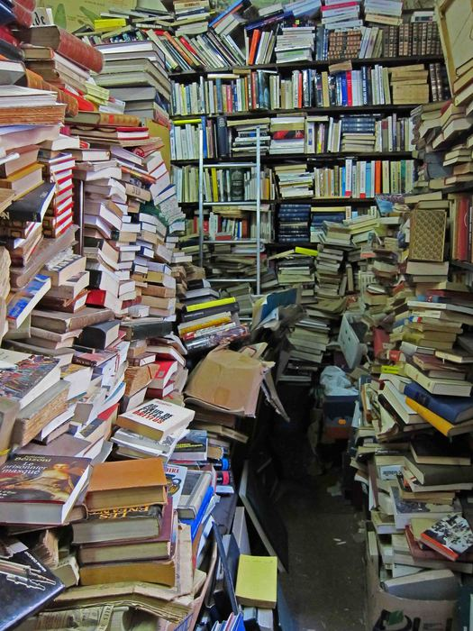
Cognitive Load and Clutter
Clutter is all the things you remove while still preserving key ideas.
Reduce clutter to minimize user’s cognitive load
Less clutter = More effective Visualization

Slide 13
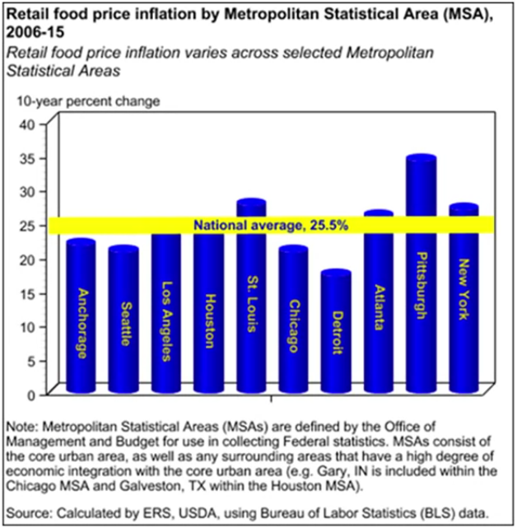
Cognitive Load and Clutter
Report of USDA’s (US Department of Agriculture) Economic Research Department
This is a regular report put out regularly by renowned statisticians.

Slide 14
Cognitive Load and Clutter
Things to be removed:
3 D effect
Overuse of bright colors. They are drawing attention to no specific place.
Yellow ticker as a threshold!
No sorting of the data?
What is x-axis for? Unhelpful axis

Slide 15
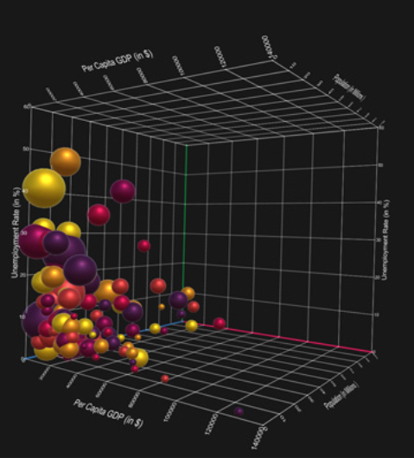
Cognitive Load and Clutter
Why not to use 3-D?
3-D doesn’t improve a Visualization
Skews information (remember Steve Jobs?)
Adds confusion

Slide 16

Cognitive Load and Clutter
Some other tips:
Use currency sign with the number
Always use percent sign when drawing percentages.
Commas with number, whenever number is bigger than 9999
Use consistent scientific notation if numbers are too big.

Slide 17
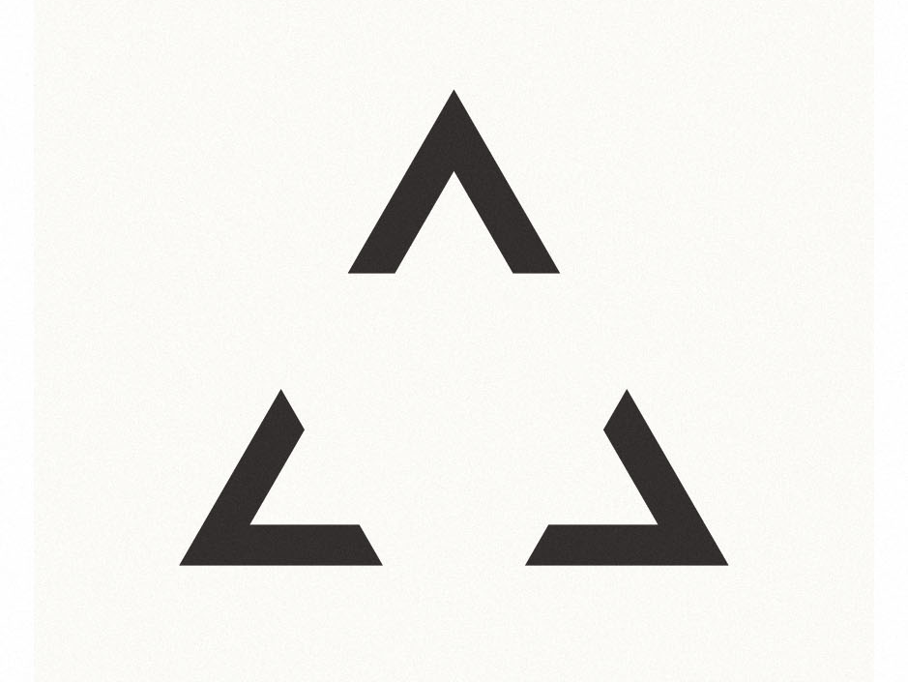
Gestalt Principles

Slide 18
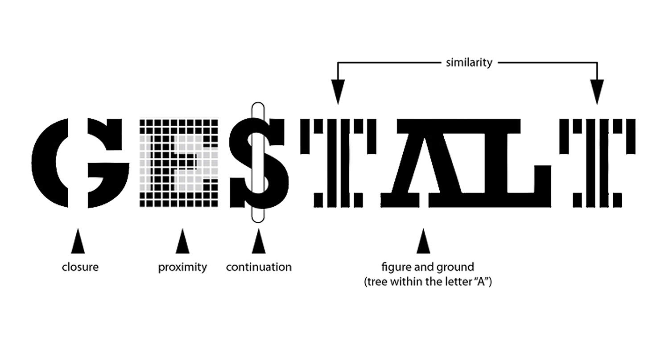
Gestalt Principles
Gestalt refers to the patterns that you perceive when presented with a few graphical elements or why we perceive things the way we do.
These rules are important when it comes to creating data visualizations to ensure efficient, clean, informative and correct information transfer.
Understanding gestalt is useful for improving traditional charts like bar charts and line charts.

Slide 19
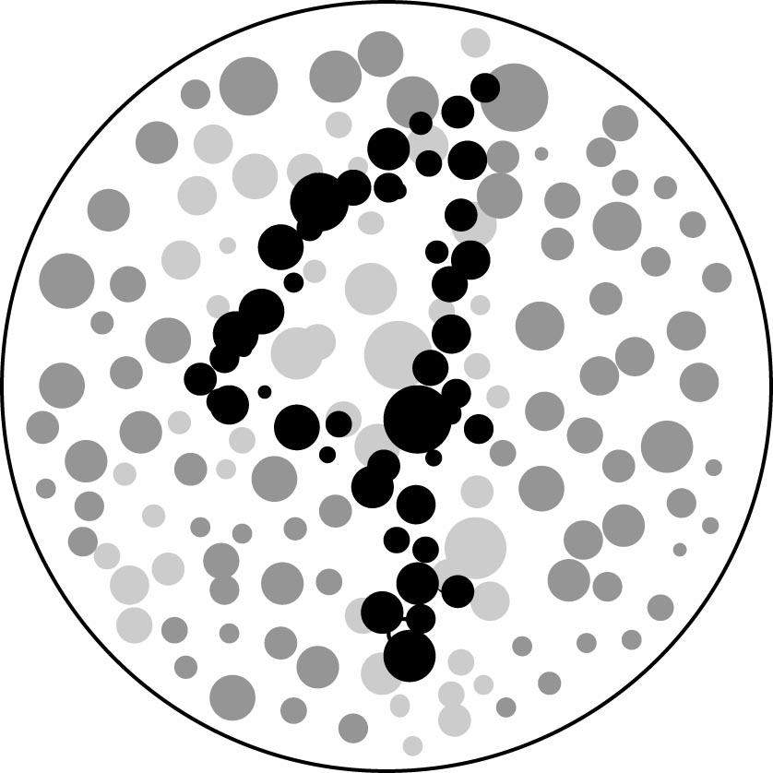
Gestalt Principles - Similarity
Items that are similar are grouped together.
Visual elements similar in shape, size, colour, proximity, motion, and direction are perceived as part of a group.
Example:
We seek patterns, easily grouping the black dots into a number 4

Slide 20

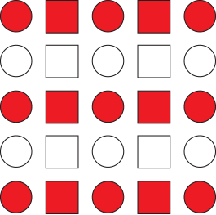
Gestalt Principles - Similarity
Example:
We perceive vertical groups of squares and circles.
Example:
We perceive horizontal groups of same red/white color elements.

Slide 21
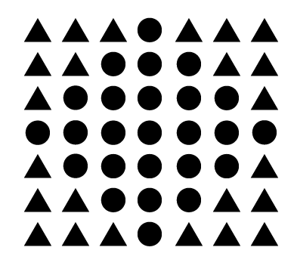
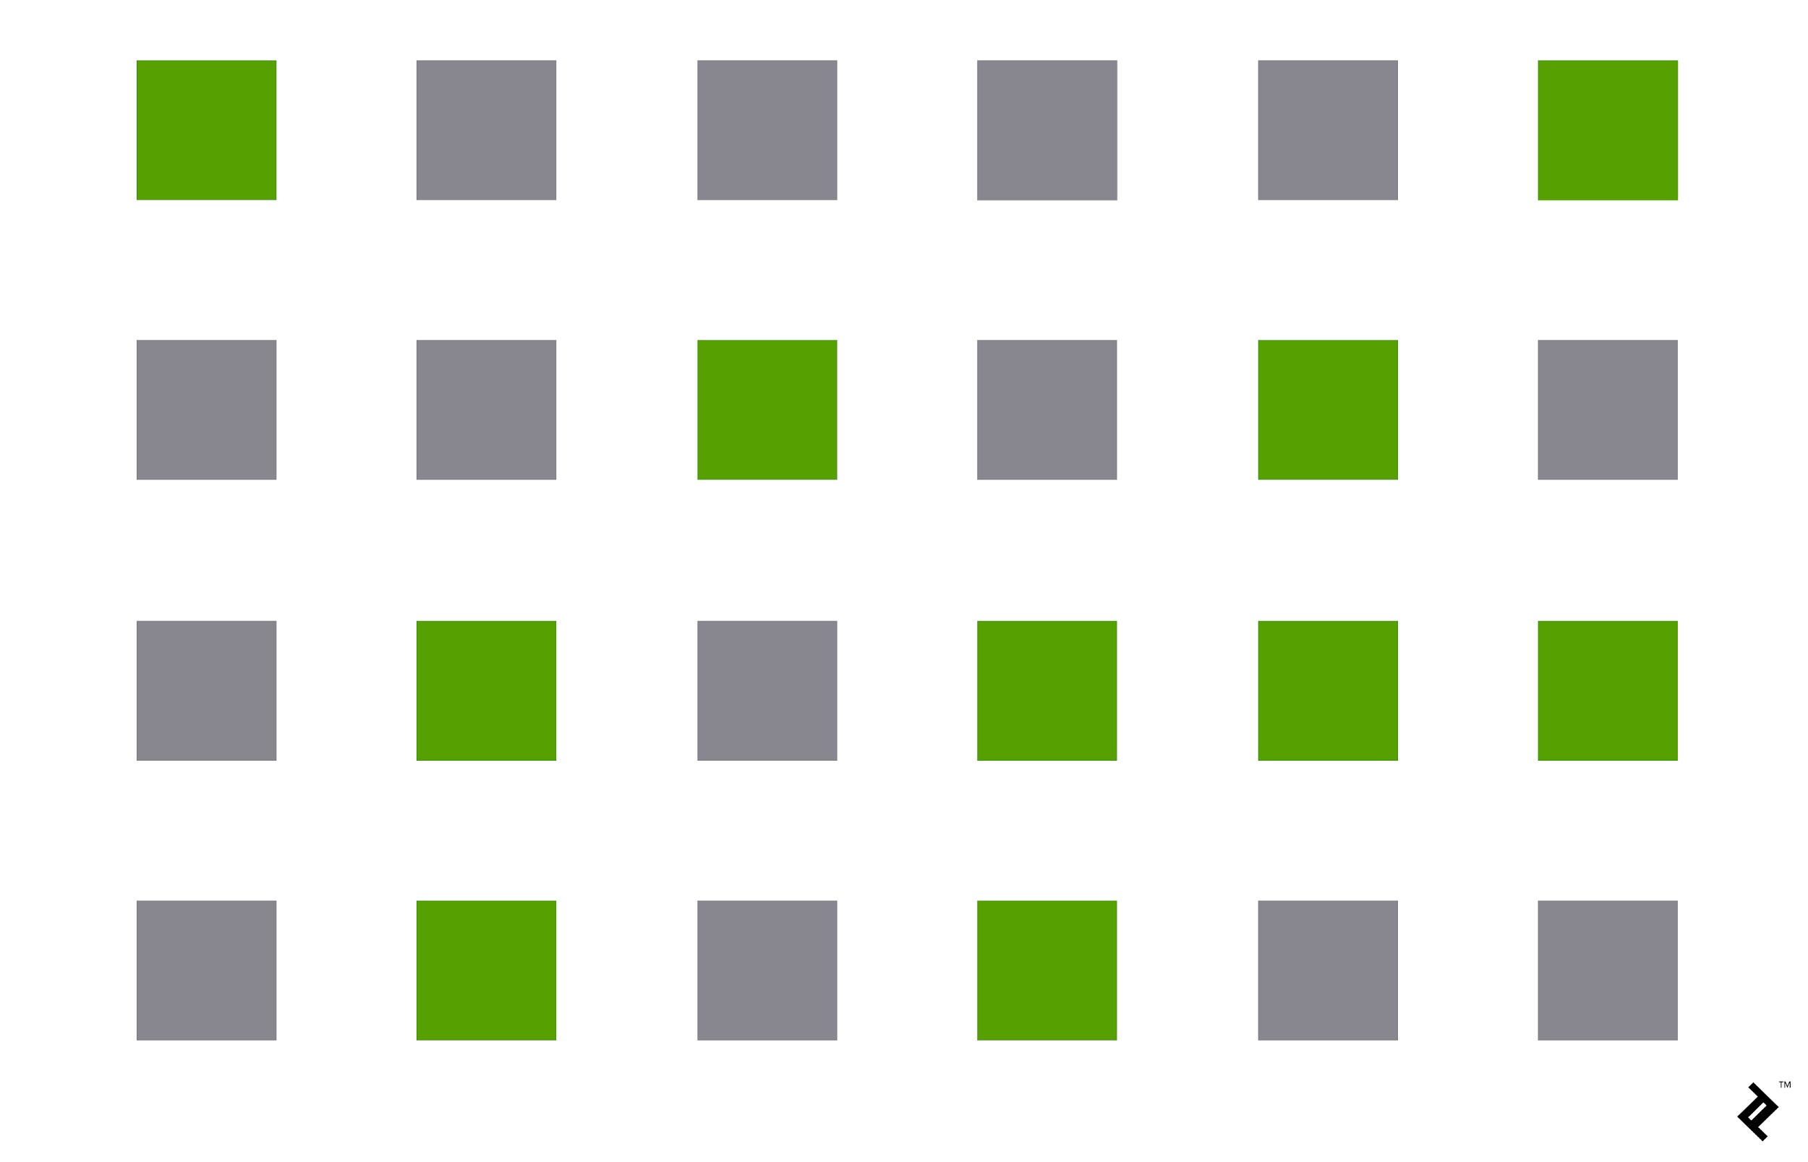
Gestalt Principles - Similarity
Example:
We perceive green/grey colored squares as a group.
Example:
A complex example of groups.

Slide 22
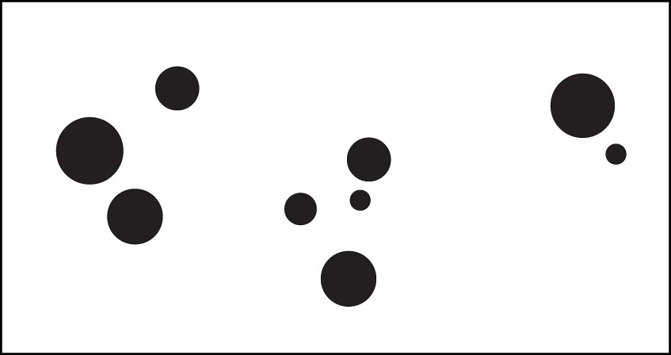
Gestalt Principles - Proximity
Objects that are close (spatially) are grouped together. The closer items are the more likely the perception they are a group.
Example:
Instead of counting numerous distinct circles we see three “groups”.

Slide 23
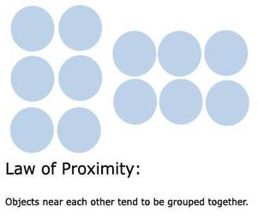
Gestalt Principles - Proximity
Example:
The circles on the left appear to be grouped in vertical columns, while those on the right appear to be grouped in the horizontal rows.

Slide 24
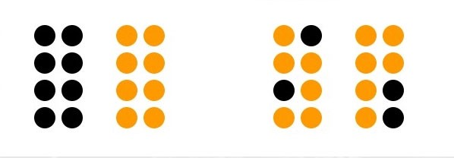
Gestalt Principles - Proximity
Example:
These groups appear to be separated by color or contrast.
Proximity overpowers other signals of distinction

Slide 25
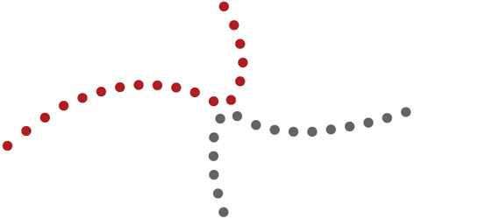
Gestalt Principles - Continuity
Lines are seen as following smoothest path.
Example:
The eye tends to want to follow the straight line from one end of this figure to the other, and the curved line from the top to the bottom, even when the lines change colour midway through

Slide 26
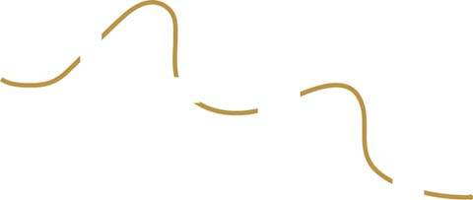
Gestalt Principles - Continuity
We perceive objects as belonging together, as part of a single whole, if they are aligned with one another or appear to form a continuation of one another.
Example:
We tend to see the individual lines as a continuation of one another, more as a dashed line than separate lines.

Slide 27
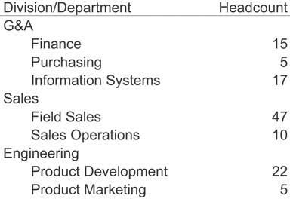
Gestalt Principles - Continuity
Things that are aligned with one another appear to belong to the same group. In the table in Figure 4-17, it is obvious which items are division names and which are department names, based on their distinct alignment. Divisions, departments, and headcounts are clearly grouped, without any need for vertical grid lines to delineate them. Even though the division and department columns overlap with no white space in between, their distinct alignment alone makes them easy to distinguish.

Slide 28
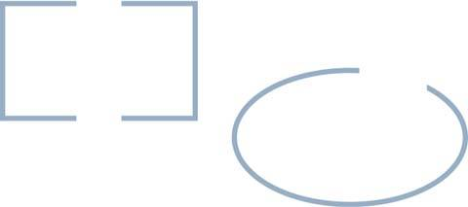
Gestalt Principles - Closure
Humans have a keen dislike for loose ends. The principle of closure asserts that we perceive open structures as closed, complete, and regular whenever there is a way that we can reasonably do so.
Example:
The Gestalt principle of closure explains why we see these as closed shapes, despite the fact that they are not finished.

Slide 29
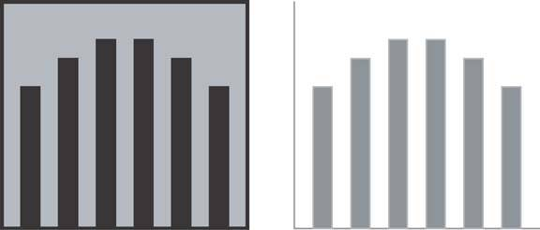
Gestalt Principles - Closure
Example:
We can apply this tendency to perceive whole structures in dashboards, especially in the design of graphs. For example, we can group objects (points, lines, or bars in a graph, etc.) into visual regions without the use of complete borders or background colours to define the space.
This is good and required so that we can reduce the clutter.
The Gestalt principle of closure also explains why only two axes, rather than full enclosure, are required on a graph to define the space in which the data appears.

Slide 30



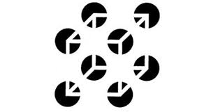
Gestalt Principles - Closure
More Example:

Slide 31
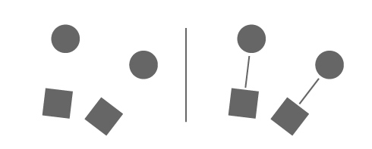
Gestalt Principles - Connectedness
Elements that are visually connected are perceived as more related than the elements with no connection.
Example:
The Gestalt principle of closure explains why we see these as closed shapes, despite the fact that they are not finished.

Slide 32
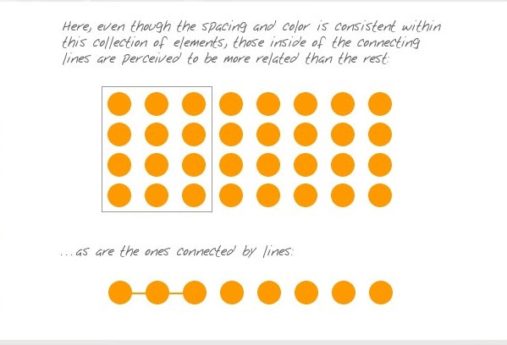
Gestalt Principles - Connectedness
Example:
Even though the spacing and the color is consistent within this collection of elements, those inside of the connecting lines are perceived to be more related than the rest.
As are the ones connected by the lines..

Slide 33
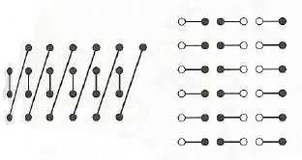
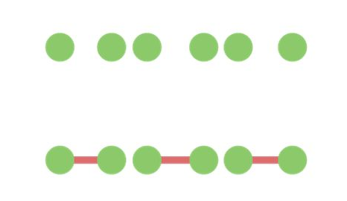
Gestalt Principles - Connectedness
Example:
And it is more powerful than proximity and similarity.

Slide 34
Pre-Attentive Attributes of a Visualization
Brain Memory
Iconic
Short Term
Long Term
Three types of memories we can influence:
We want to get something in readers brain without them even to think about it.
Why?
This decreases the cognitive load while conveying the information so that there is not much work to be done by the brain to understand.

Slide 35
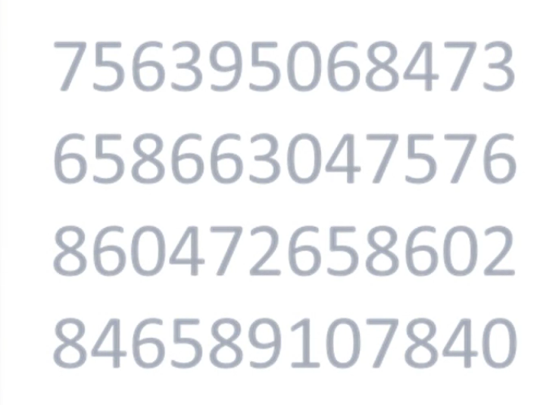
Pre-Attentive Attributes of a Visualization
Example: Count the total number of 4’s in the figure.

Slide 36
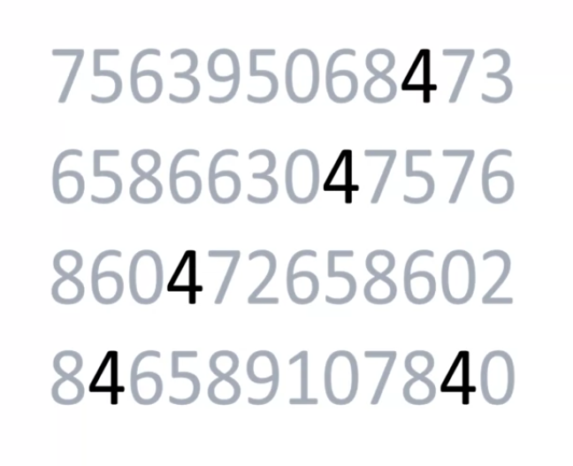
Pre-Attentive Attributes of a Visualization
Example: Now count the total number of 4’s in the figure. See the difference?

Slide 37

Pre-Attentive Attributes of a Visualization
Good visualization allow users to see what we want them to see before they know that they have seen it.

Slide 38
Pre-Attentive Attributes of a Visualization
So, how do I do all that?

Slide 39
Pre-Attentive Attributes of a Visualization
Change one of these to focus on users attention:
Size
Color
Orientation
$h@pe
Line composition
Enclosure
Intensity
Position

Slide 40
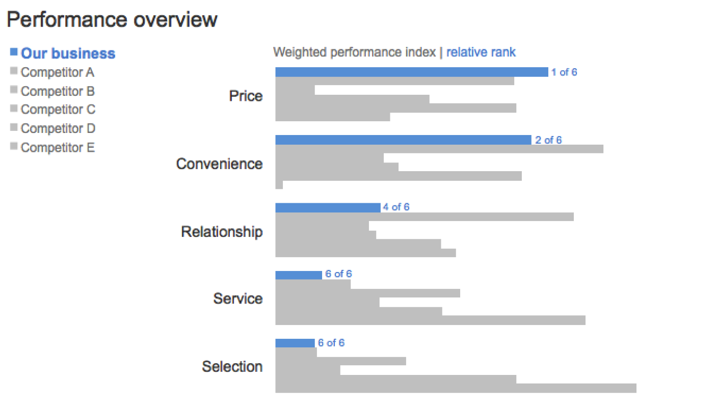
Pre-Attentive Attributes of a Visualization

